Slide 1
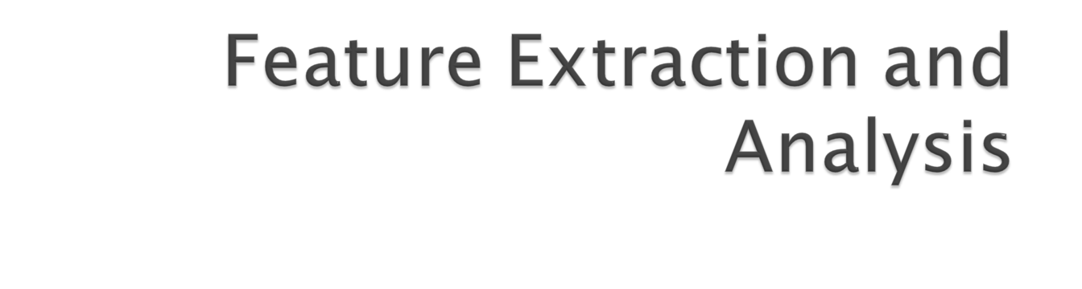
Lecture 3

Slide 2

Introduction
Feature Extraction
  Shape Features - Binary Object Features
  Histogram Features
  Feature Vectors and Feature Spaces

Slide 3

The goal in image analysis is to extract useful information for solving application-based problems.
The first step to this is to reduce the amount of image data using methods that we have discussed before:
  Image pre-processing

Slide 4
The next step would be to extract features that are useful in solving computer imaging problems.
What features to be extracted are application dependent.
After the features have been extracted, then analysis can be done.

Slide 5

Depend on a silhouette (outline) of an image
All that is needed is a binary image

Slide 6

In order to extract object features, we need an image that has undergone image segmentation and any necessary morphological filtering.
This will provide us with a clearly defined object which can be labeled and processed independently.

Slide 7
After all the binary objects in the image are labeled, we can treat each object as a binary image.
  The labeled object has a value of ‘1’ and everything else is ‘0’.
The labeling process goes as follows:
  Define the desired connectivity.
  Scan the image and label connected objects with the same symbol.

Slide 8
After we have labeled the objects, we have an image filled with object numbers.
This image is used to extract the features of interest.
Among the binary object features include area, center of area, axis of least second moment, perimeter, Euler number, projections, thinness ration and aspect ratio.

Slide 9
In order to extract those features for individual object, we need to create separate binary image for each of them.
We can achieve this by assigning 1 to pixels with the specified label and 0 elsewhere.
  If after the labeling process we end up with 3 different labels, then we need to create 3 separate binary images for each object.

Slide 10

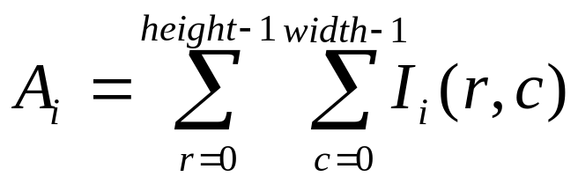
The area of the ith object is defined as follows:
The area A_{i} is measured in pixels and indicates the relative size of the object.

Slide 11

The perimeter is defined as the total pixels that constitutes the edge of the object.
Perimeter can help us to locate the object in space and provide information about the shape of the object.
Perimeters can be found by counting the number of ‘1’ pixels that have ‘0’ pixels as neighbors.

Slide 12
Perimeter can also be found by applying an edge detector to the object, followed by counting the ‘1’ pixels.
The two methods above only give an estimate of the actual perimeter.
An improved estimate can be found by multiplying the results from either of the two methods by π/4.

Slide 13

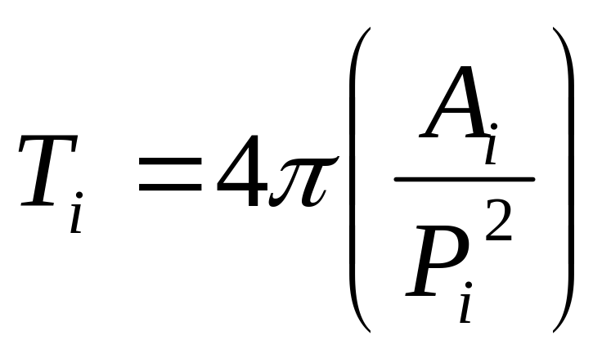
The thinness ratio, T, can be calculated from perimeter and area.
The equation for thinness ratio is defined as follows:

Slide 14
The thinness ratio is used as a measure of roundness.
  It has a maximum value of 1, which corresponds to a circle.
  As the object becomes thinner and thinner, the perimeter becomes larger relative to the area and the ratio decreases.

Slide 15
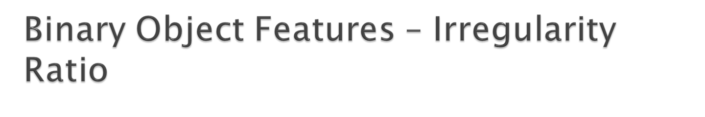
The inverse of thinness ration is called compactness or irregularity ratio, 1/T.
This metric is used to determine the regularity of an object:
  Regular objects have less vertices (branches) and hence, less perimeter compare to irregular object of the same area.

Slide 16

The aspect ratio (also called elongation or eccentricity) is defined by the ratio of the bounding box of an object.
This can be found by scanning the image and finding the minimum and maximum values on the row and column where the object lies.

Slide 17
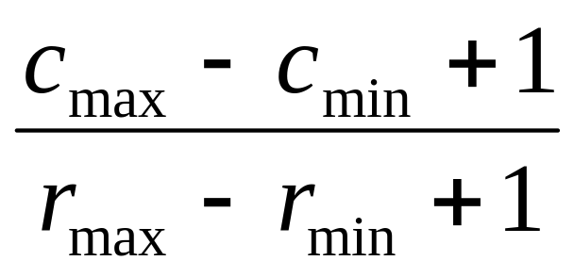
The equation for aspect ratio is as follows:
It reveals how the object spread in both vertical and horizontal direction.
High aspect ratio indicates the object spread more towards horizontal direction.

Slide 18

Euler number is defined as the difference between the number of objects and the number of holes.
  Euler number = num of object – number of holes
In the case of a single object, the Euler number indicates how many closed curves (holes) the object contains.

Slide 19
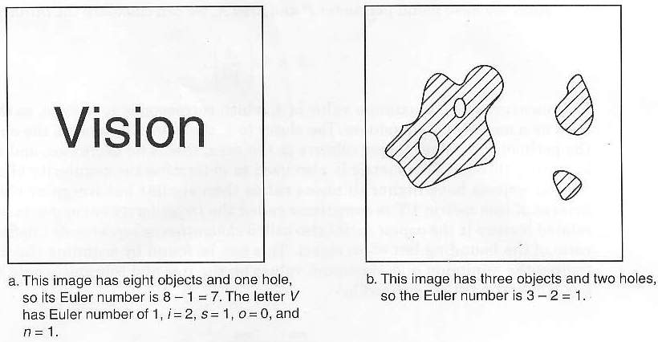
Euler number can be used in tasks such as optical character recognition (OCR).

Slide 20
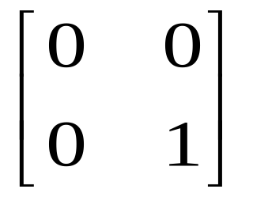
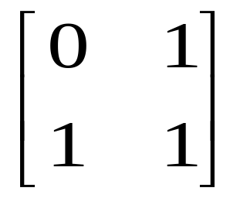
Euler number can also be found using the number of convexities and concavities.
  Euler number = number of convexities – number of concavities
This can be found by scanning the image for the following patterns:
Convexities
Concavities

Slide 21

The projection of a binary object, may provide useful information related to object’s shape.
It can be found by summing all the pixels along the rows or columns.
  Summing the rows give horizontal projection.
  Summing the columns give the vertical projection.

Slide 22
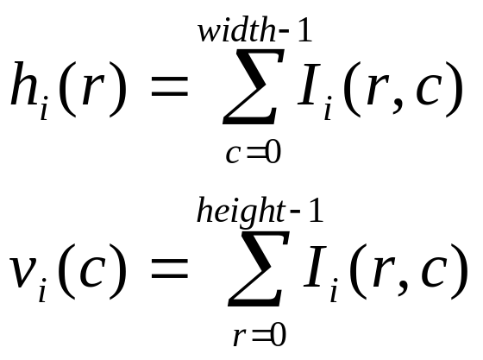
We can defined the horizontal projection h_{i}(r) and vertical projection v_{i}(c) as:
An example of projections is shown in the next slide:

Slide 23

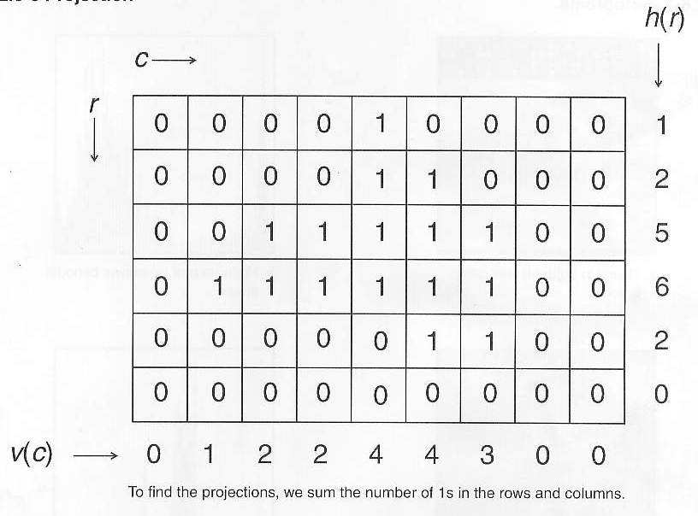

Slide 24

The histogram of an image is a plot of the gray-level values versus the number of pixels at that value.
The shape of the histogram provides us with information about the nature of the image.
  The characteristics of the histogram has close relationship with characteristic of image such as brightness and contrast.

Slide 25

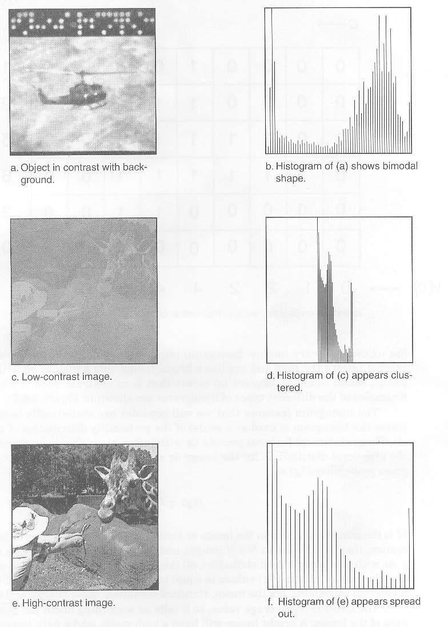

Slide 28
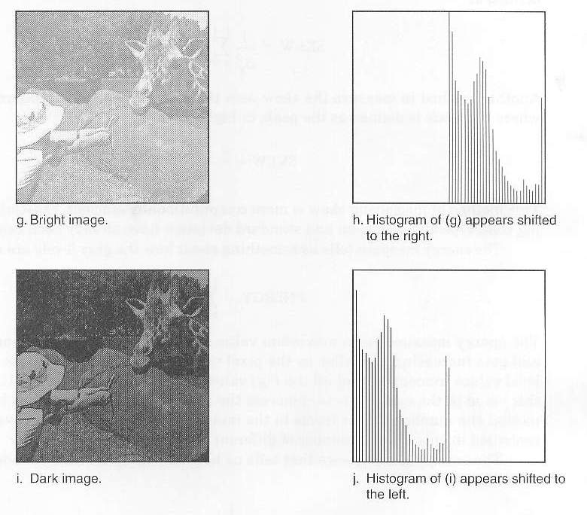

Slide 30
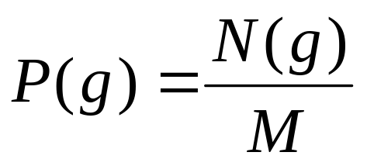
The histogram is used as a model of the probability distribution of gray levels.
The first-order histogram probability P(g) is defined as follows:
P(g) : probability of gray level g in image
N(g) : number of pixel with gray level g in image
M : total number of pixel in image

Slide 31
The features based on the first-order histogram probability are
  Mean
  Standard deviation
  Skew
  Energy
  Entropy.

Slide 32

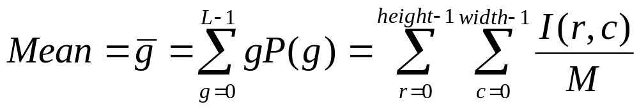
The mean is the average value, so it tells us something about the general brightness of the image.
  A bright image has a high mean.
  A dark image has a low mean.
The mean can be defined as follows:

Slide 33

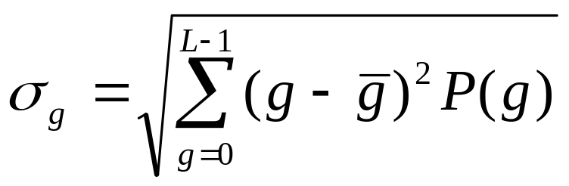
The standard deviation, which is also known as the square root of the variance, tells something about the contrast.
It describes the spread in the data.
  Image with high contrast should have a high standard deviation.
The standard deviation is defined as follows:

Slide 34

The skew measures the asymmetry (unbalance) about the mean in the gray-level distribution.
Image with bimodal histogram distribution (object in contrast background) should have high standard deviation but low skew distribution (one peak at each side of mean).

Slide 35
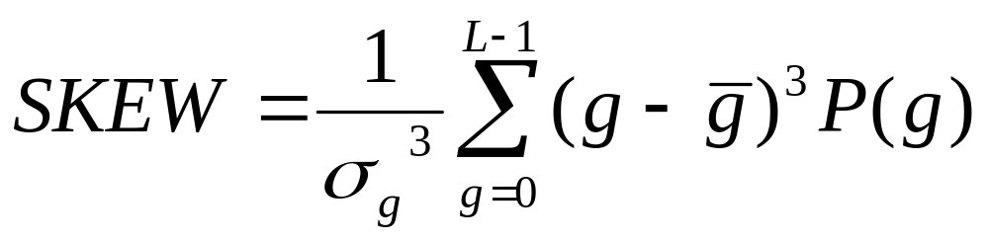
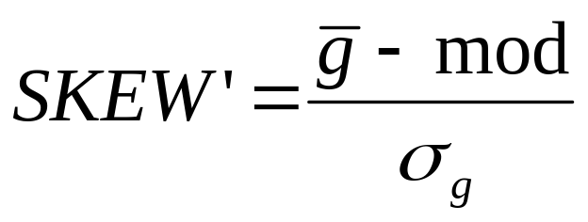
Skew can be defined in two ways:
In the second method, the mod is defined as the peak, or highest value.

Slide 36

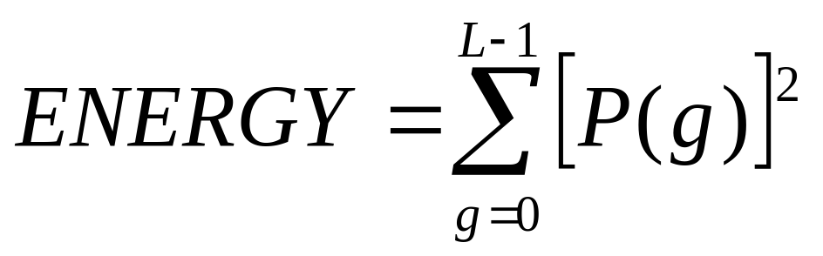
The energy measure tells us something about how gray levels are distributed.
The equation for energy is as follows:

Slide 37
The energy measure has a value of 1 for an image with a constant value.
This value gets smaller as the pixel values are distributed across more gray level values.
A high energy means the number of gray levels in the image is few.
  Therefore it is easier to compress the image data.

Slide 38

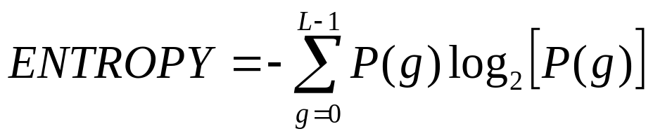
Entropy measures how many bits do we need to code the image data.
The equation for entropy is as follows:
As the pixel values are distributed among more gray levels, the entropy increases.

Slide 39

A feature vector is a method to represent an image or part of an image.
A feature vector is an n-dimensional vector that contains a set of values where each value represents a certain feature.
This vector can be used to classify an object, or provide us with condensed higher-level information regarding the image.

Slide 40

Let us consider one example:
We need to control a robotic gripper that picks parts from an assembly line and puts them into boxes (either box A or box B, depending on object type). In order to do this, we need to determine:
1) Where the object is
2) What type of object it is
The first step would be to define the feature vector that will solve this problem.

Slide 41
To determine where the object is:
Use the area and the center area of the object, defined by (r,c).
To determine the type of object:
Use the perimeter of object.
Therefore, the feature vector is: [area, r, c, perimeter]

Slide 42
In feature extraction process, we might need to compare two feature vectors.
The primary methods to do this are either to measure the difference between the two or to measure the similarity.
The difference can be measured using a distance measure in the n-dimensional space.

Slide 43

A mathematical abstraction which is also n-dimensional and is created for a visualization of feature vectors

Slide 44

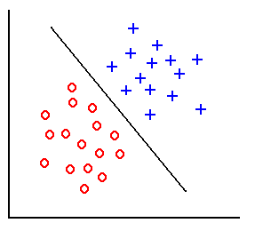


Feature vectors of x₁ and x₂ and two classes represented by x and o.
Each x & o represents one sample in feature space defined by its values of x₁ and x₂

Slide 45

Feature Extraction
  Binary Object Features (Area, Center of Area, Axis of Least Second Moment, Perimeter, Thinness Ratio, Irregularity, Aspect Ratio, Euler Number, Projection)
  Histogram Features (Mean, Standard Deviation, Skew, Energy, Entropy)
  Feature Vectors and Feature Spaces

